Slide 1
  Lesson5: Administrator

Slide 2
Lesson 5: Administrator
Administrator tab contains following Sub Tabs
  Users
  Configuration
  Entity Configuration
  Processing Configuration
Notes:
Let’s drive you through the Administrator tab of ProducerPro.

Slide 3
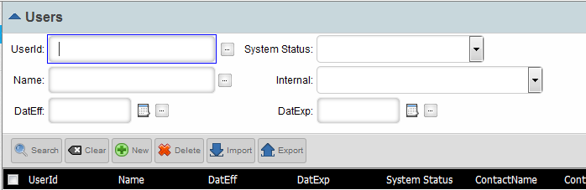
Lesson 5: Users
Creation/Modification of new/existing users.
Administrator->Users.
Step 1:
New Users
Existing Users
Notes:
User creation is the main entry point of ProducerPro, access of individual can be created only from this UI.

Slide 4
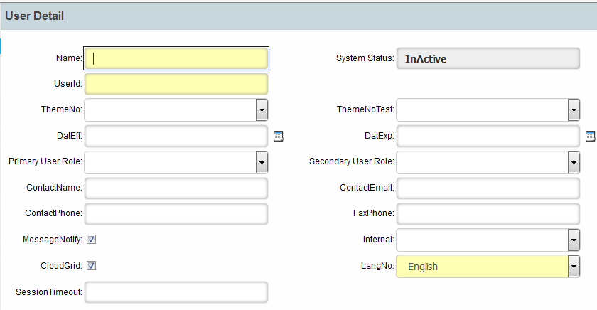
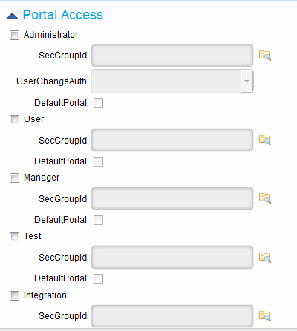
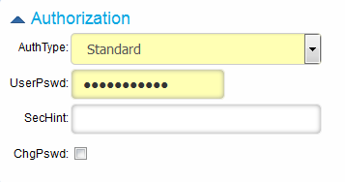
Lesson 5: Users…
Step 2: Fill up the mandatory fields marked in “Yellow”, complete the steps shown, Save -> Activate.
Access you want to provide
Set the password here
Notes:
Now comes the related fields to create access and permission portal.

Slide 5
Lesson 5: Configuration – Code Type Search
Code Types / Code Values
These tables are used for configuration of system-defined or user-defined Values and Descriptions for “Code Type” type of fields.
For example, a Code Type of LOACODE will be associated to any field that should contain LOA Code values. The list of valid LOA Code values and their associated Descriptions are configured in the Code Values table. Each client can have their own list of LOA Code values and descriptions.
Some Code Types are system-defined but allow the configurator to change the Description for display purposes. The Code Values are pre-defined by the system. An example of this type of Code Type may be Status values for an inbound table. The system is using/expecting specific values, but the configurator can change the Descriptions.
Some Code Types are pre-defined in the system but allow the configurator to define the list of valid Values and associated Descriptions.
Some Code Types are created by the configurator for a specific client implementation. This allows the configurator to define all attributes for the Code
Type, all Values and Descriptions, and associate the Code Type to specific fields.
Notes:
Let’s now enter into the Configuration part, to start with is “Code Types / Code Values”
These tables are used for configuration of system-defined or user-defined Values and Descriptions for “Code Type” type of fields.
For example, a Code Type of LOACODE will be associated to any field that should contain LOA Code values. The list of valid LOA Code values and their associated Descriptions are configured in the Code Values table. Each client can have their own list of LOA Code values and descriptions.
Some Code Types are system-defined but allow the configurator to change the Description for display purposes. The Code Values are pre-defined by the system. An example of this type of Code Type may be Status values for an inbound table. The system is using/expecting specific values, but the configurator can change the Descriptions.
Some Code Types are pre-defined in the system but allow the configurator to define the list of valid Values and associated Descriptions.
Some Code Types are created by the configurator for a specific client implementation. This allows the configurator to define all attributes for the Code
Type, all Values and Descriptions, and associate the Code Type to specific fields.

Slide 6
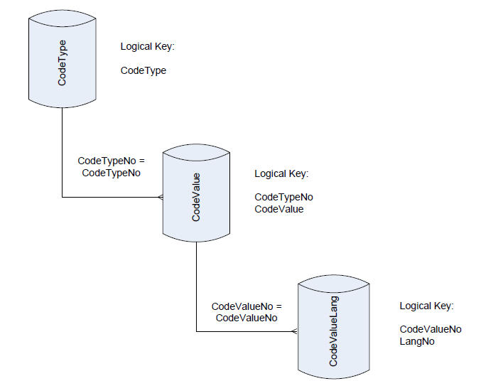
Lesson 5: Code Tables Relationships
Notes:
Relationship between code tables and their keys.

Slide 7
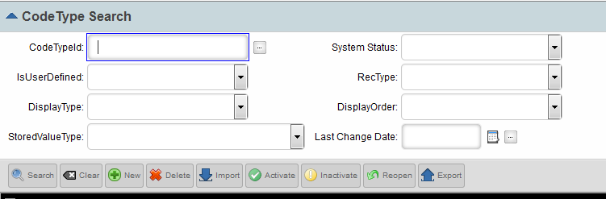
Lesson 5: Configuration – Code Type Search
Now its time to learn Drop down list creation.
Administrator->Configuration->Code Type Search
Step 1:-
Search existing
New Creation
Notes:
Here comes the UI part of Code Type configuration as well as searching an existing value.

Slide 8
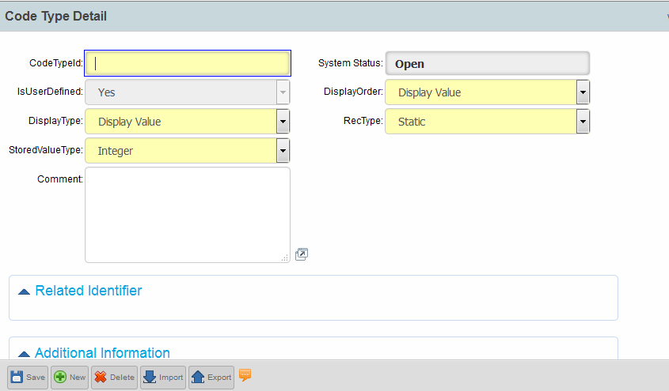
Lesson 5: Configuration – Code Type Search
Step 2:-
Drop Down List Name
Data Type of the list
Save
Notes:
Display Type signifies the value which can be seen from UI, Stored Value Type is the datatype of the values to be stored in database.

Slide 9
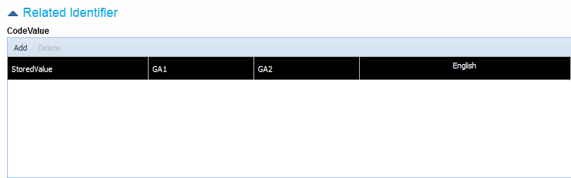
Lesson 5: Configuration – Code Type Search
Step 3:-
Add Values
Value added here shows in database
Value added here shows in UI
Save
Activate
Notes:
The values needed to create the list can be configured here, Stored Value stores in database, English is the display value. The GA1, GA2 fields are few fields given to accommodate extra values, this cannot be seen in UI but only in DB. One can add new fields(i.e GA3, GA4, GA5….GAn) to accommodate values as per requirement. Let’s take a look on how to configure additional fields in upcoming slides.

Slide 10
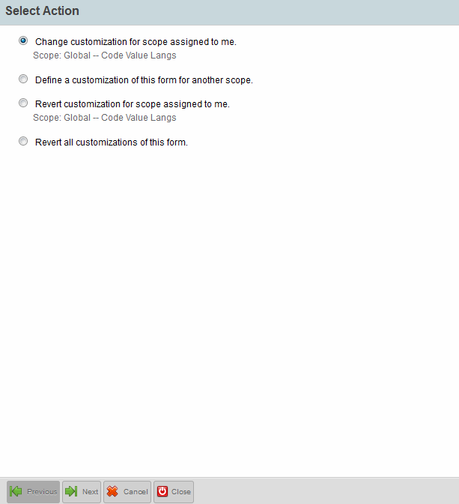
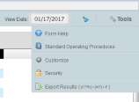
Lesson 5: Configuration – Code Type Search
Customize
Notes:
Click on the Code Type that you have created with additional fields, a new pop-up window appears. On the right corner you will find the “Tools” button, after clicking you will see the screen shown. Click on Customize as shown, it opens “Form Customization”, click on “Next”.

Slide 11
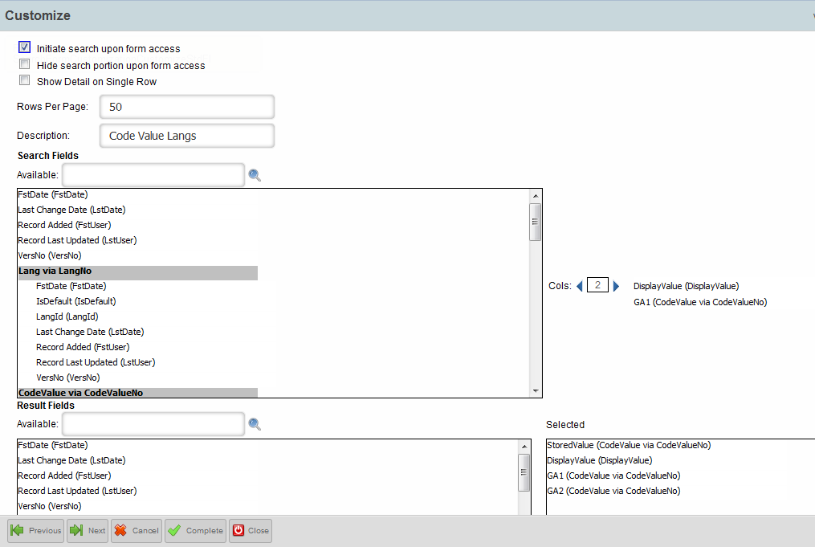
Lesson 5: Configuration – Code Type Search
Notes:
Clicking takes you to this screen, where you can drag newly added fields from left to right pane as part of UI configuration. Once done click on Next and then Complete.

Slide 12


Lesson 5: Configuration – Code Type Search
To modify/delete CodeType values.
To change any existing value enter the value and then click on Update.
Save
Activate
Notes:
For any modification, you need to select the CodeType, click on “Update” to update existing value. For deletion, select the value and click on “Delete”.

Slide 13
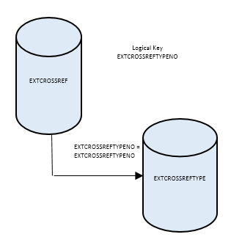
Lesson 5: Cross Tables Relationships
Notes:
Relationship between cross-reference tables and their keys.

Slide 14
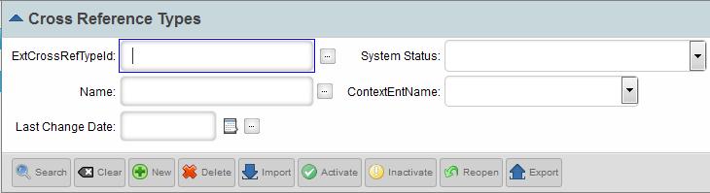
Lesson 5: Configuration – Cross Reference Types
Learn to create External Cross Reference Type and Values creation
  Stores user defined types, values
  Has extended number of fields and values and can accommodate more custom fields
  Typically used to configure Jurisdiction, Product Licensing Rules, Product Specific Training, detailed Titles etc.
Administrator->Configuration->Cross Reference Types
Step 1:-
New Creation
Notes:
Learn to create External Cross Reference Type and Values creation
Stores user defined types, values
Has extended number of fields and values and can accommodate more custom fields
Typically used to configure Jurisdiction, Product Licensing Rules, Product Specific Training, detailed Titles etc.

Slide 15
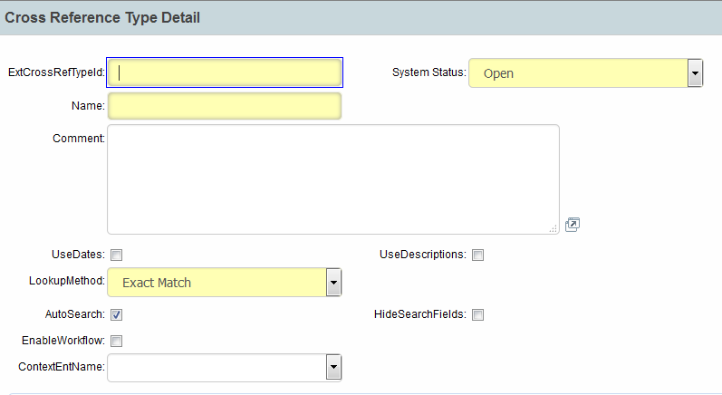
Lesson 5: Configuration – Cross Reference Types
Step 2:-
Name of Xref to be created
Check Box – 0 – No date configured
1 - Date Configured

Slide 16
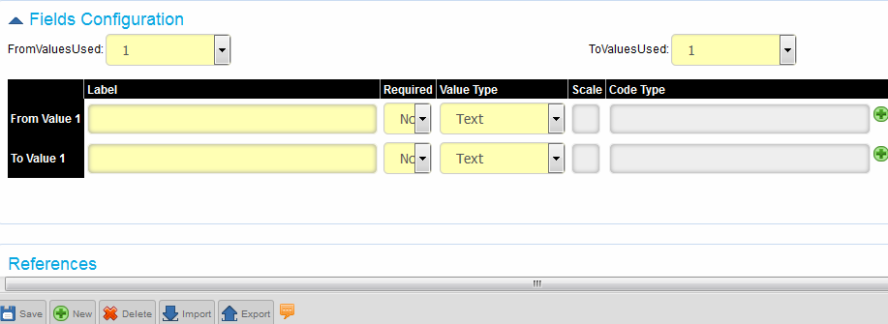
Lesson 5: Configuration – Cross Reference Types
Step 2:- Save -> Activate
Type of value the field can hold eg. Drop-down, text etc.
Need to select the configured Code Type if Value Type selected is “Code”
Notes:
You can increase the “FromValuesUsed” and “ToValuesUsed” to configure per requirement. It helps to have customized columns. But it is sequential i.e you cannot have mixture of “FromValuesUsed” and “ToValuesUsed” . First “FromValuesUsed” will appear followed by “ToValuesUsed” .

Slide 17

Lesson 5: Configuration – Cross Reference Types
How to search an existing Xref Table and Data
Step 1:-
Search existing
Notes:
To search an existing Xref Table along with its data content.

Slide 18
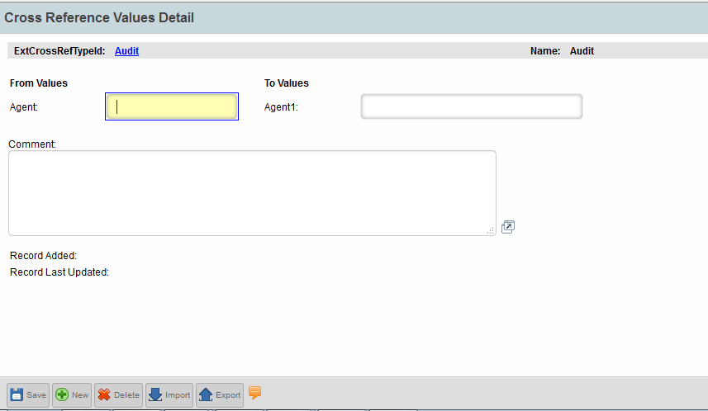
Lesson 5: Configuration – Cross Reference Types
Step 2:- To add values to new and existing fields. Add values. Click on Save->Activate.
Save
Notes:
This will help you learn how to add values into the Xref table that you have configured.

Slide 19
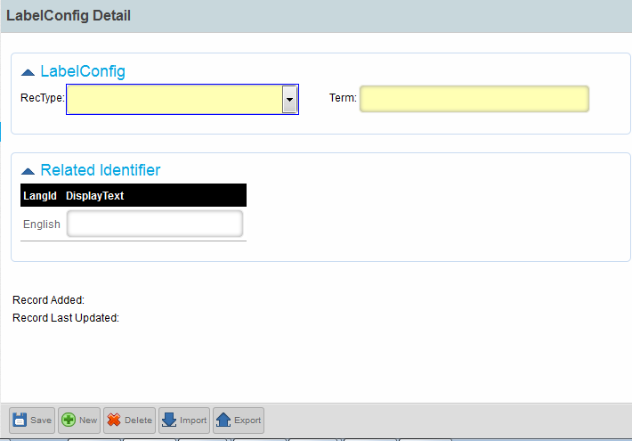
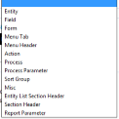
Lesson 5: Configuration – LabelConfig Search
Name which needs rename for UI display.
Select from the drop down of the RecType for which you need to provide the Display Name.
UI display name
Notes:
Suppose, you want to give a different UI name for a particular field/form. This is the place to act on. Type in where you need the change in “RecType” field (i.e. form, field etc.), enter the name which needs to be renamed in “Term” and “English” hold the name you want.

Slide 20
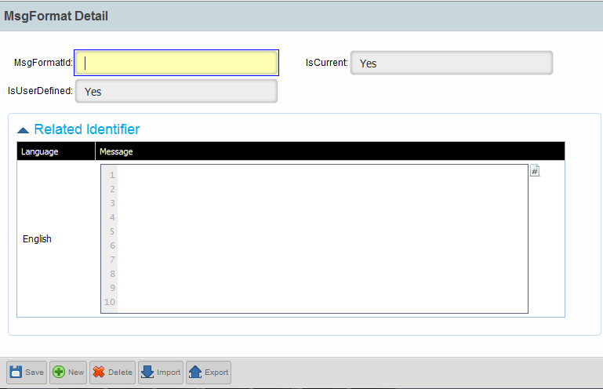
Lesson 5: Configuration – MsgFormat Search
To provide Warning/Error message based on business need to user.
Add details. Click on Save->Activate.
Unique Id for message
Add text that needs to be displayed to user for Warning/Error. This is the display message for WS fields.
Save
Notes:
This slide will help you learn how to configure Warning/Error message based on business need to user.

Slide 21
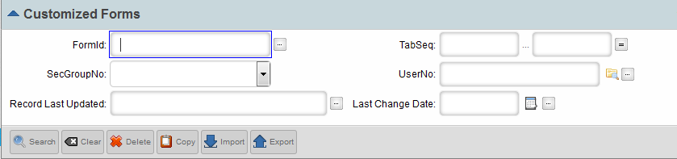
Lesson 5: Configuration – Customized Forms
This is mainly to create/modify Workspace(WS) fields that is displayed on screen.
The names with suffix DFI are the ones used for WS activities.
Step 1:
Search
Notes:
Learn to create/modify Workspace(WS) fields that is displayed on screen.The names with suffix DFI are the ones used for WS activities.

Slide 22
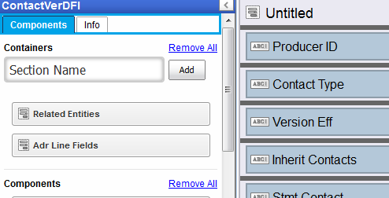


Lesson 5: Configuration – Customized Forms
Step 2:
Click On Customize
Columns to add into Right Pane
Creates Section on Right Pane
Save

Slide 23
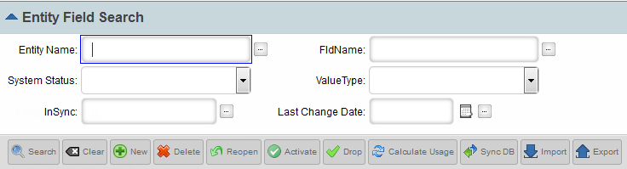
Lesson 5: Entity Configuration – Entity Field Search
Used to create/modify attributes for the pmpro entities except the “Standard Fields”.
“Standard Fields” are system defined fields designed by Callidus, which is not shown here and cannot be modified.
To Search an attribute from any Entity.
Search
Notes:
Creation/modification of attributes for the pmpro entities except the “Standard Fields” is an essential part of configuration.“Standard Fields” are system defined fields designed by Callidus, which is not shown here and cannot be modified.

Slide 24
Lesson 5: Entity Configuration – Entity Field Search
Steps to add an attribute. After completion on Step 2.
Click on Activate, after Save and Run “SyncDB*” which is mandatory to add the field into database. Unless “SyncDB*” is executed the new attribute will not get reflected into the DB.
Step 1:
New
*SyncDB
Notes:
One should remember any operation performed needs to be Synced with DB else it will be useless.

Slide 25
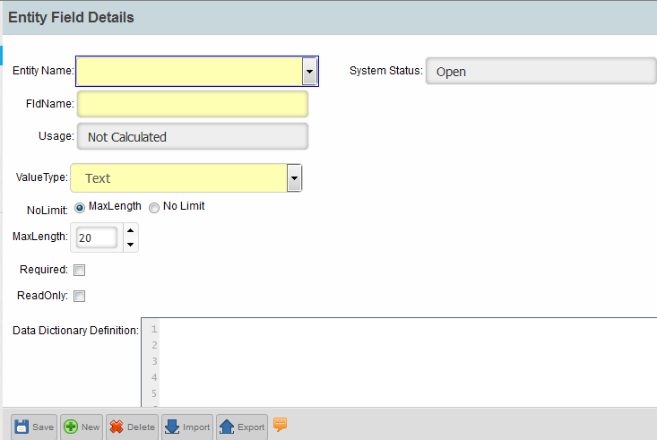
Lesson 5: Entity Configuration – Entity Field Search
Entity List
Step 2:
Attribute Name
Data Type
Save
Notes:
Screen to perform the action.

Slide 26
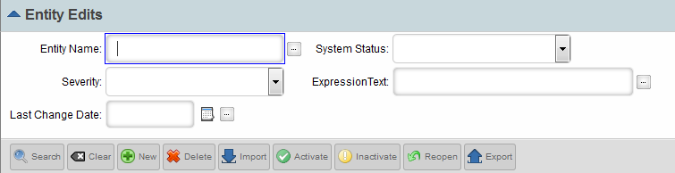
Lesson 5: Entity Configuration – Entity Edits
Used to restrict user input by throwing Warning/Error into the screen. Usually this restriction is based on business need.
To Search an existing Entity Edits
Search
Notes:
The upcoming slides will help you to learn on how to restrict user input by throwing Warning/Error into the screen. Usually this restriction is based on business need.

Slide 27
Lesson 5: Entity Configuration – Entity Edits
Steps to create Entity Edits
Step 1:
New
Notes:
Let’s now understand how Entity Edits can be created

Slide 28
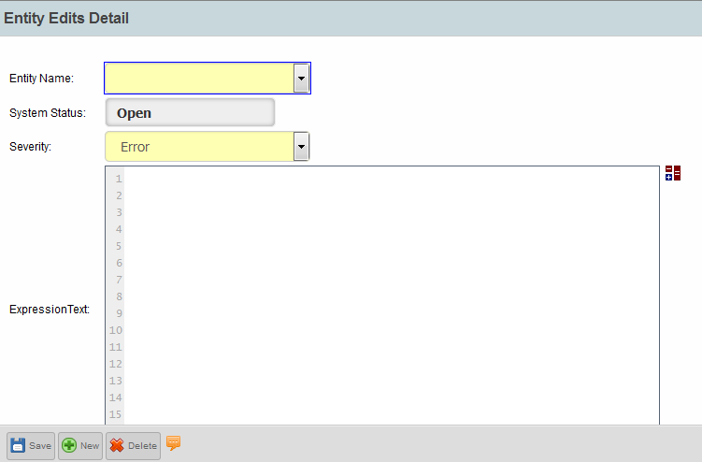
Lesson 5: Entity Configuration – Entity Edits
Step 2:
Entity on which Restriction is needed.
Severity Type – Error/Warning
Click to write Expression in a different window.
Notes:
Clicking on the arrow shown will open a new window having expressions, attributes that can be chosen for configuration.

Slide 29
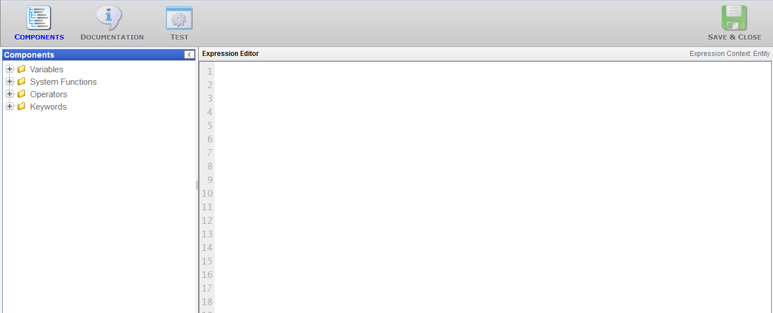
Lesson 5: Entity Configuration – Entity Edits
Step 3:
Choose Attributes for the Entity chosen, add functions, operation and keywords as provided from left pane as per business needs.
Notes:
Choose Attributes for the Entity chosen, add functions, operation and keywords as provided from left pane as per business needs.

Slide 30
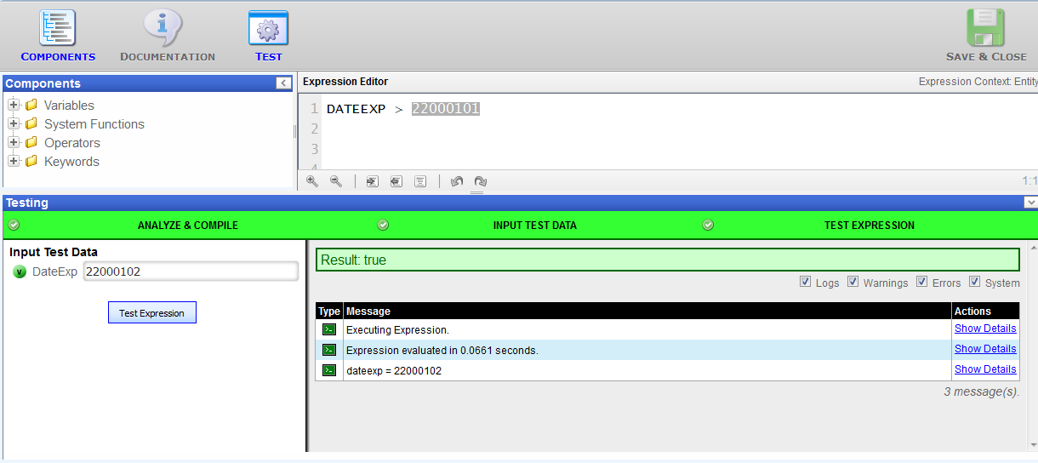
Lesson 5: Entity Configuration – Entity Edits
Step 4:
Click on Test for expression testing.
If the color is “Green” and the output is as expected then the Expression can be Save -> Activate.
Notes:
Click on Test for expression testing. If the color is “Green” and the output is as expected then the Expression can be Save -> Activate.

Slide 31
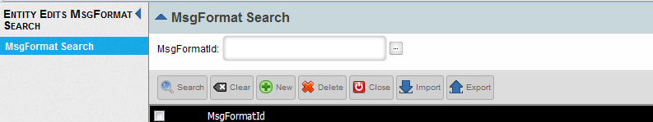
Lesson 5: Entity Configuration – Entity Edits
Step 5:
Select
To add new message
Search for existing
Notes:
Now its time to add the message that we have created in Slide 10.

Slide 32
Test Your Understanding
  How do we create a new user?

Slide 33
Test Your Understanding
  Are CodeType and CodeTypeValues related?

Slide 34
Test Your Understanding
  What are the purpose of having CodeType values?

Slide 35
Test Your Understanding
  Entity Edits are used to generate

Slide 36
Test Your Understanding
  An attribute has been added to an entity from UI, but is not visible in database.
  What did the user miss?

Slide 37

Summary
You should now be able to work on:
  User creation/modification.
  Creation of Code Type, Code Values and their relationships
  Creation of Xref tables along with their utilities.
  Creation/Modification of attributes along with restriction on usage.
Notes:
You should now be able to work on
User creation/modification.
Creation of Code Type, Code Values and their relationships
Creation of Xref tables along with their utilities.
Creation/Modification of attributes along with restriction on usage.

